Slide 1
Arduino obstacle avoiding + voice control + Bluetooth control Robot | DIY Arduino Robot
DIY PROJECT
TEAM ID 15
ABHISHEK SAJWAN(22BT30001)
ADITYA KUMAR BHARTI(22CS30007)
DAKSH SINGH DESHLAN(22MA10020)
KORABU BISWAJEET NAIDU(22CY10027)

Slide 2
index
Introduction
Objectives
Materials used
Items specifications
Schematic diagram of the setup
Circuit diagram
Features of the code
Photographs of final system
Challenges faced and solutions found
Learning’s from the project
Who did what?
Conclusions
References and Youtube links

Slide 3
introduction
An obstacle avoiding robot or a car is a device in motion that avoids colliding with an obstacle either by taking a turn or by stopping at the obstacle. This prevents the robots cause damage and casualties.
Such systems minimize repair costs, vehicle downtime, and injuries by avoiding collisions. This technology is easy to install.
The ability to reliably detect vehicles offers significant advantages for asset management, resource allocation, site safety, and traffic control.

Slide 4
Our 3 objectives
Obstacle avoiding
Remote control
Voice control
Remote control robots are automatic robots that require human intervention through a transmitter and receiver system, in order to make them perform a desired function.
The objective of voice controlled robotic vehicle (VCRV) is to listen and act on the commands of the user.
Obstacle avoidance robot is design to allow robot to navigate in unknown environment by avoiding collisions . Obstacle avoiding robot senses obstacles in the path ,avoid it and resumes its running.

Slide 5
Materials USed:-
1.Arduino Uno x 1 ---
2.Gear motor x 4 ---
3.Robot wheel x 4. ---
4.Motor Driver(L293D) x1. ---
5.Ultrasonic sensor x 1 ---
6.Bluetooth module x 1 ---
7.Li-ion battery x 3. ---
8.Li-ion battery holder x 1 --
9.Jumper Wires ----
10.Card Board x 1. ---
11.Switch x 1.---
12. Servo motor x 1. --

Slide 6
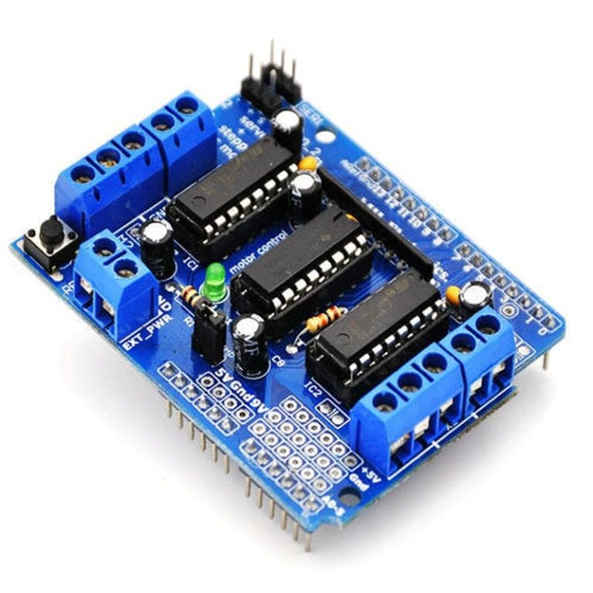

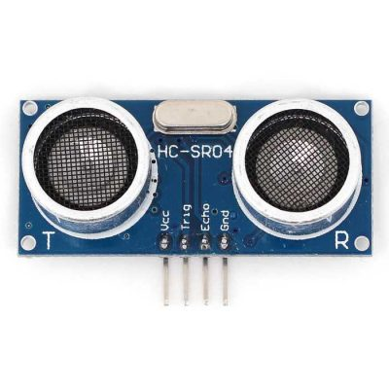
Items specifications
Motor drive
Arduino uno
Ultrasonic sensor
L293D motor driver chip
Four H-bridges
Terminal blocks for power supply and DC motors
Reset button
Big terminal block connectors (10-22 AWG)
PCB Size: 69 x 53 mm
Microcontroller: ATmega328P
Operating Voltage: 5V
Input Voltage (recommended): 7-12V
Input Voltage (limit): 6-20V
Digital I/O Pins: 14 (of which 6 provide PWM output)
PWM Digital I/O Pins: 6
Analog Input Pins: 6
DC Current per I/O Pin: 20 mA
DC current for 3.3V Pin: 50 mA
Flash Memory: 32 KB (ATmega328P)
SRAM: 2 KB (ATmega328P)
EEPROM: 1 KB (ATmega328P)
Clock Speed: 16 MHz
LED_BUILTIN: 13
Length: 68.6 mm
Width: 58.4 mm
Weight: 25 g
Power Supply: DC 5V
Working Current: 15mA
Working Frequency: 40Hz
Ranging Distance : 2cm – 400cm/4m
Resolution : 0.3 cm
Measuring Angle: 15 degree
Trigger Input Pulse width: 10uS
Dimension: 45mm x 20mm x 15mm

Slide 7
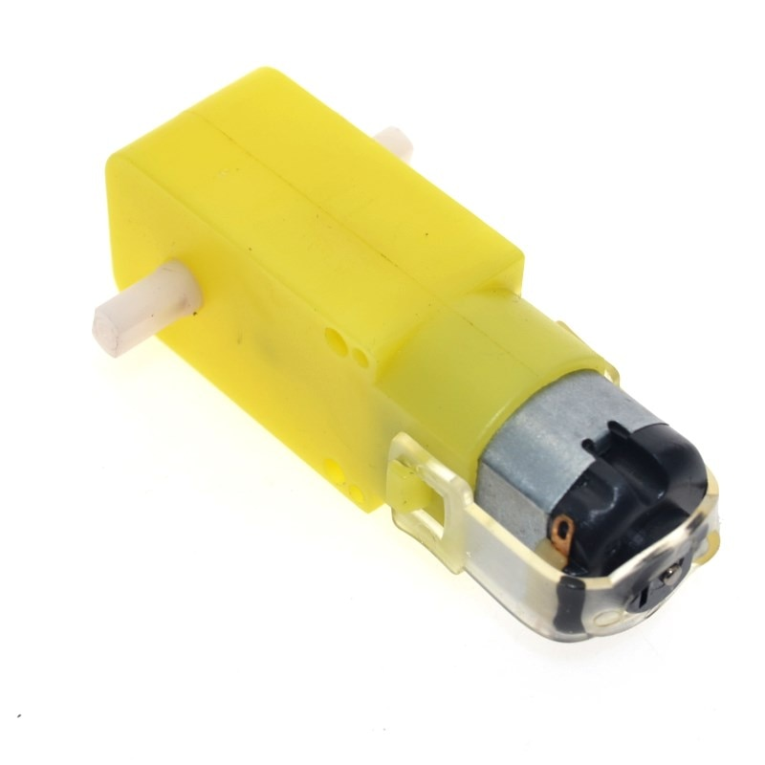
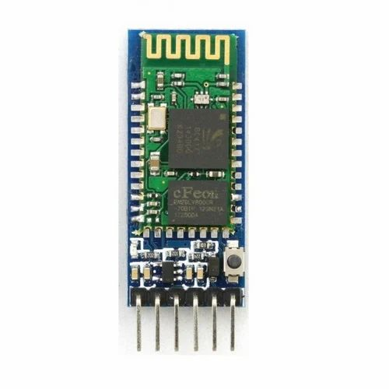
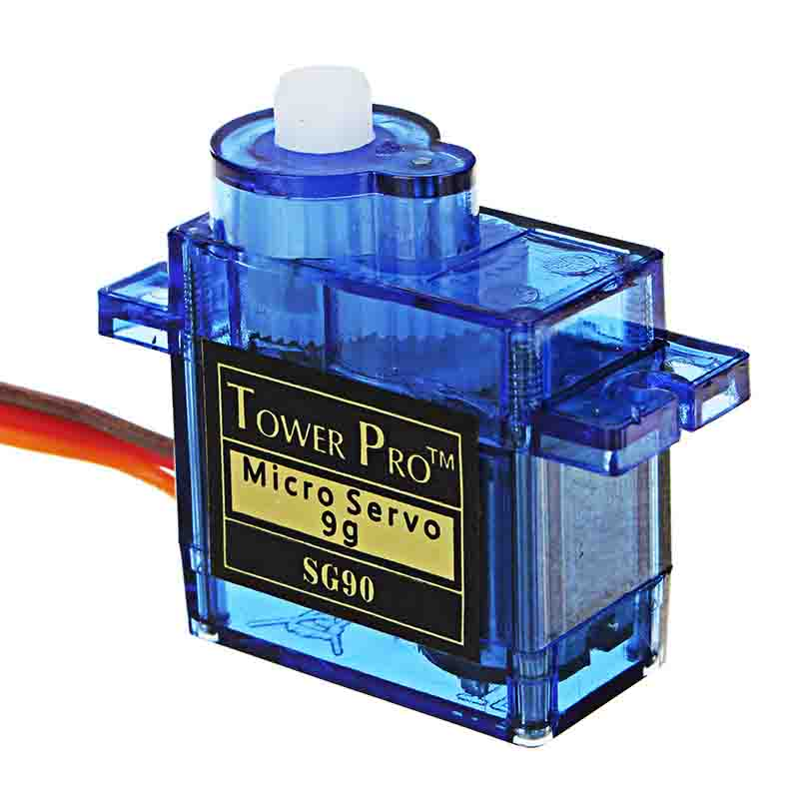
Items specifications
gear motor
Bluetooth module
Servo motor
Rated voltage: 3 - 6VDC
Continuous No-Load Current: <150mA @ 3V
Min. Operating Speed (3V): 90RPM
Min. Operating Speed (6V): 200RPM
Torque: 0.15Nm ~0.60Nm
Stall Torque (6V): 0.8kg.cm
Gear Ratio: 1:48
Bluetooth protocol: Bluetooth Specification v2.0+EDR
Frequency: 2.4GHz ISM band
Modulation: GFSK(Gaussian Frequency Shift Keying)
Emission power: =4dBm, Class 2
Sensitivity: =-84dBm at 0.1% BER
Speed: Asynchronous: 2.1Mbps(Max) / 160 kbps, Synchronous: 1Mbps/1Mbps
Power supply: +3.3VDC 50mA
Dimension: 26.9mm x 13mm x 2.2 mm
Operating Voltage is +5V typically
Torque: 2.5kg/cm
Operating speed is 0.1s/60°
Gear Type: Plastic
Rotation : 0°-180°
Weight of motor : 9gm
Package includes gear horns and screws
v

Slide 8
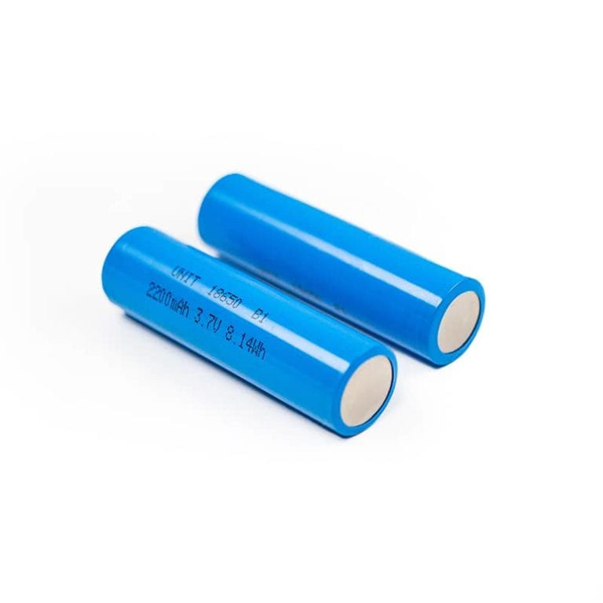
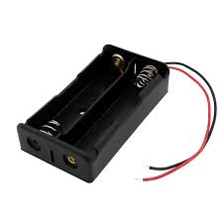
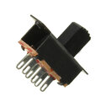
Items specification
li-on battery
battery holder
switch
Nominal Voltage: 3.6V
Nominal Capacity: 2,850 mAh
Minimum Discharge Voltage: 3V
Maximum Discharge current: 1C
Charging Voltage: 4.2V (maximum)
Charging current: 0.5C
Charging Time: 3 hours
Charging Method: CC and CV
Cell Weight: 48g
Cell Dimension: 18.4mm (dia) and 65mm (height)
Double slot 18650 Battery Cell Holder
Support Model:18650 Battery
Shell material: ABS
Terminal: copper-nickel plating
Corn: Nickel plated with copper
Dimension: 77.1mm x 39.8mm X 14.9mm
Color: Black
Pin: 6/pc
Rated voltage: 0.5A 50V DC
Overall size: about 23 x 19 x 6.5mm(L x H x W)
Actuator Height: about 7mm
Panel cut-out dimension: 15.5 x 6.5mm
Screw holes: about 19mm apart
This Photo by Unknown Author is licensed under CC BY-NC-ND

Slide 9
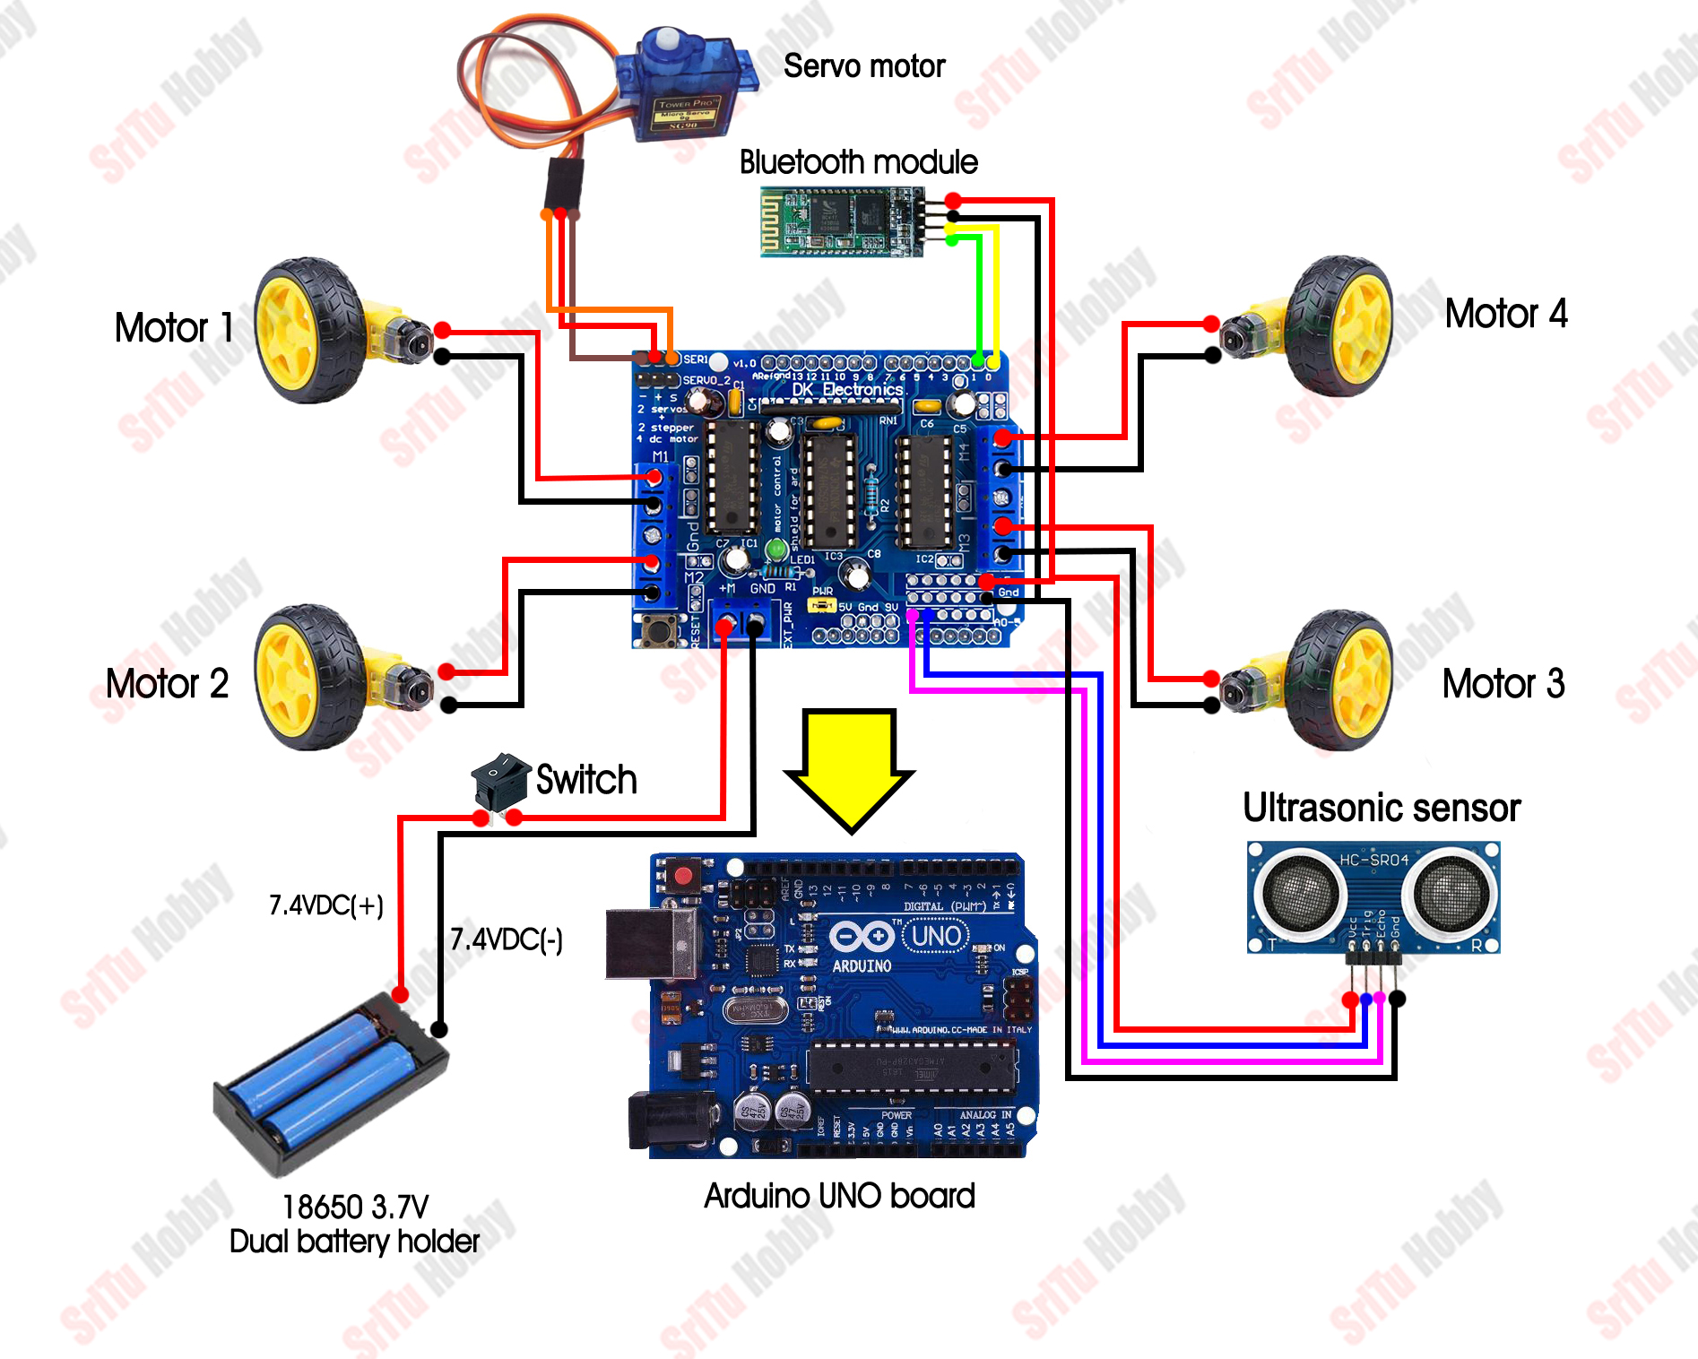

Slide 10
features of the code
1. Integration of Libraries: The code includes the necessary libraries (Servo.h and AFMotor.h)
to utilize the Servo and Adafruit Motor functionalities.
2. Bluetooth Remote Control: The car can be controlled via Bluetooth by sending specific commands
('F' for forward, 'B' for backward, 'L' for left, 'R' for right, and 'S' for stop) through serial
communication.
3. Obstacle Avoiding: The ultrasonic sensor is used to detect obstacles in front of the car. If an
obstacle is detected within a certain threshold, the car stops, moves backward, rotates to
check the left and right distances, and adjusts its direction accordingly.
4. Voice Control: The car can also be controlled by voice commands sent through serial
communication. Commands ('^' for forward, '-' for backward, '<' for left, '>' for right, and ‘*’
for stop) are interpreted, and the car's movement is adjusted accordingly.
5. Motor Control: The code utilizes the AFMotor library to control the DC motors connected
to the motor drive. Different functions are implemented to control forward,
backward, right, left, and stop movements of the car.
6. Servo Motor Control: A servo motor is used to rotate the ultrasonic sensor for obstacle
detection. The servo is attached to a specified pin, and functions are implemented to
control its movement.

Slide 11
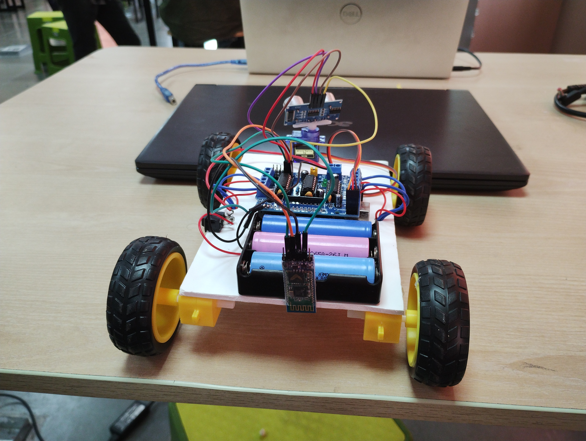
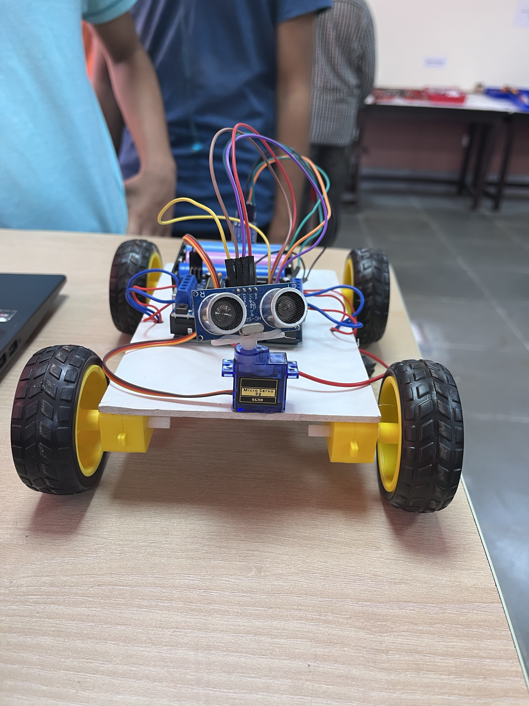
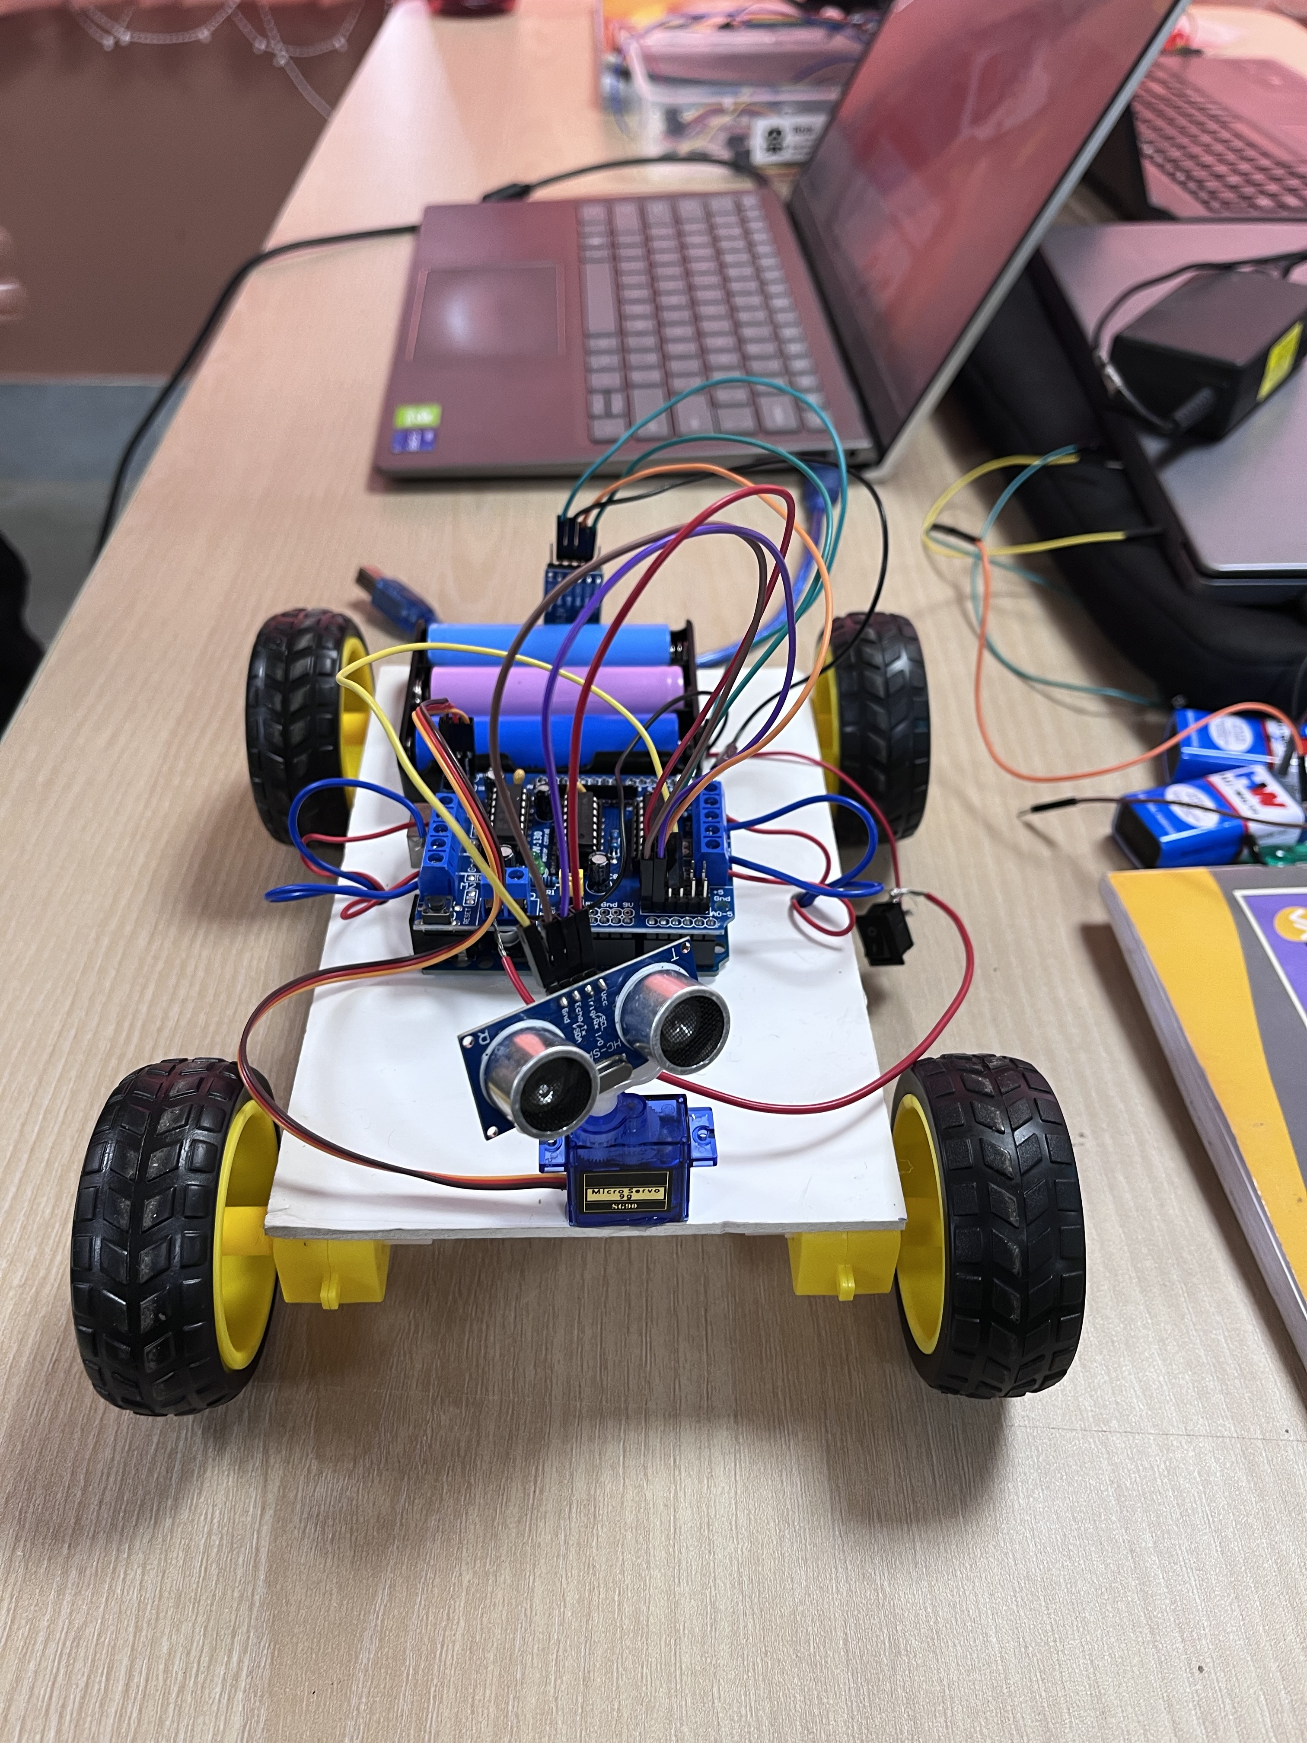
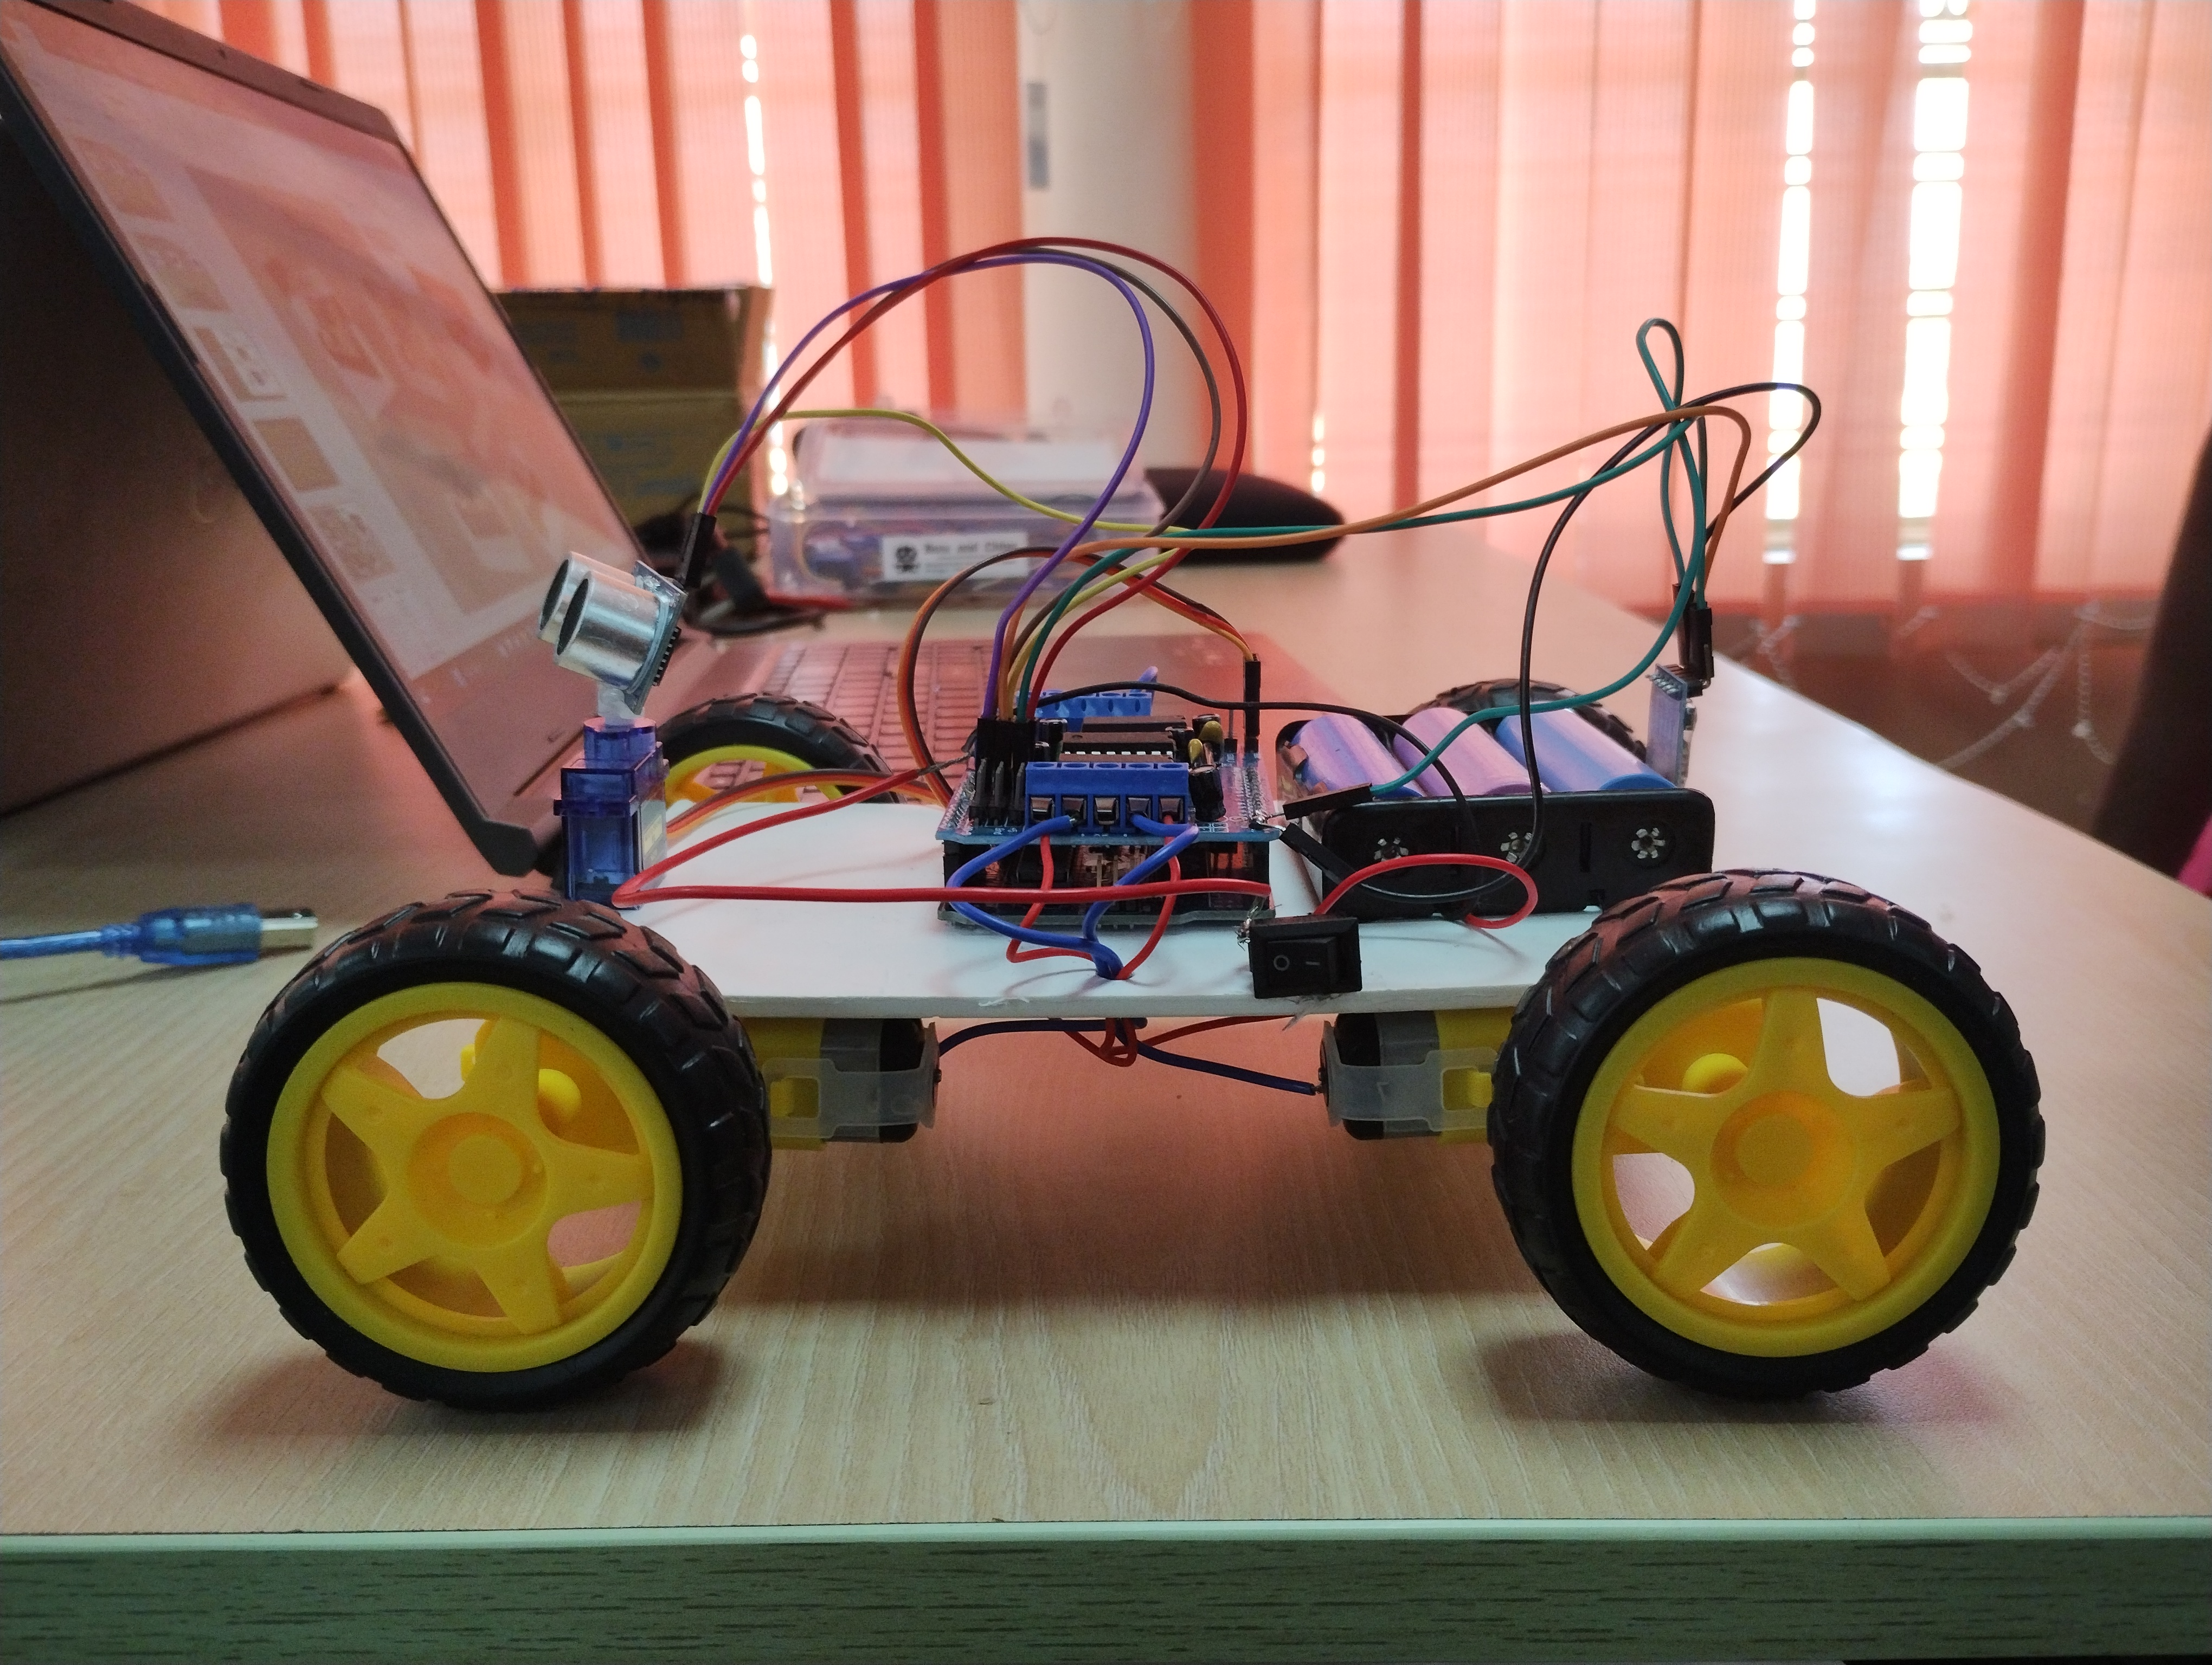
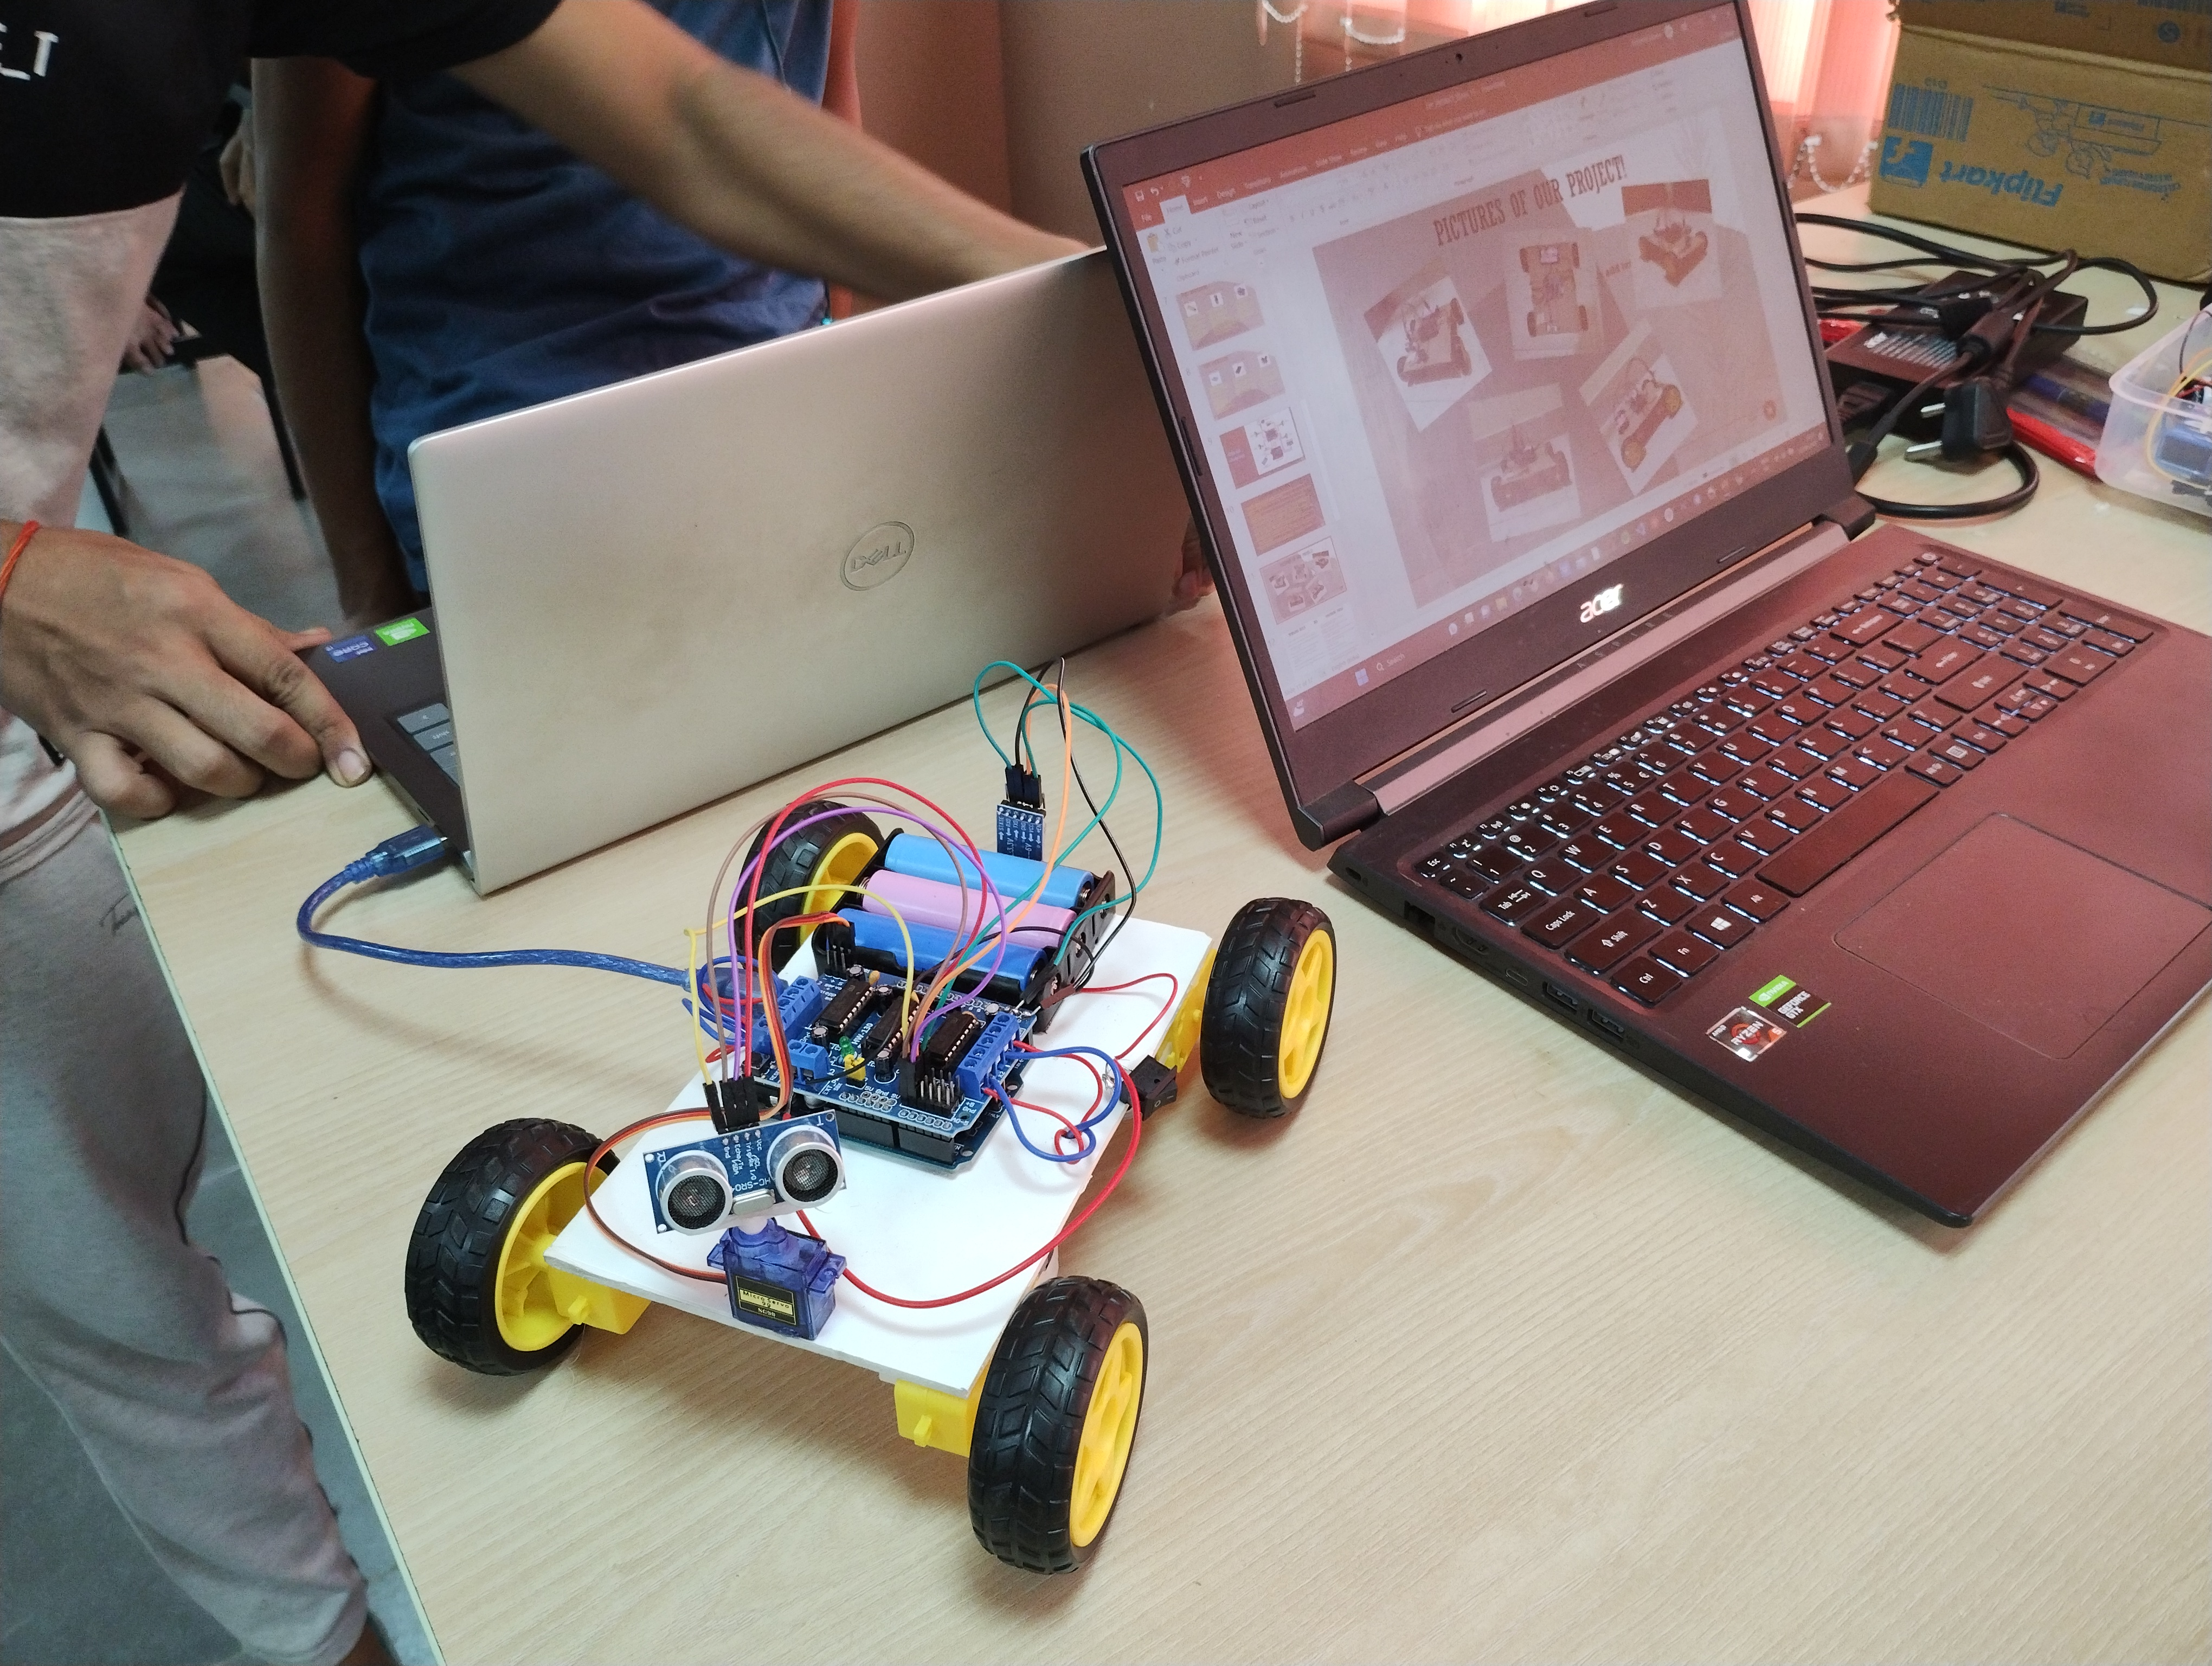
Pictures of our project!

Slide 12
Problems faced AND Solutions found
.AFMotor library file was missing which is needed to include in the code.
Pins to be used in the Arduino were too loose.
Due to a random connection , all the motors were running in different directions.
There was the source provided for the library in the source we used for our project so we installed it.
Finally we solder the pins for better circuit connections.
We look individually for each motors and make them rotate in the proper direction.

Slide 13
Distributions of our Roles
ABHISHEK
SAJWAN
ADITYA
KUMAR
BHARTI
KORABU
BISWAJEET
NAIDU
DAKSH
SINGH
DESHLAN
assembly
Materials
Software and Soldering
assembly
Software
assembly
soldering
assembly
materials

Slide 14
Conclusion:-
This project involved the making of a Arduino obstacle avoiding + voice control + Bluetooth control Robot ( DIY Arduino Robot), a motor drive, Bluetooth module, and an ultrasonic sensor. The main objective was to develop a car that could be controlled by Bluetooth remote and also through voice commands by our phone and could detect obstacles to avoid collisions. Throughout the project, various challenges were encountered, including the integration of hardware components, programming the car's movements and responses etc. By overcoming these challenges, valuable learnings were gained such as practical hardware integration, sensor integration, voice recognition, and the development of programming and problem-solving skills. This project provided practical insights into the world of robotics and the integration of hardware and software.

Slide 15
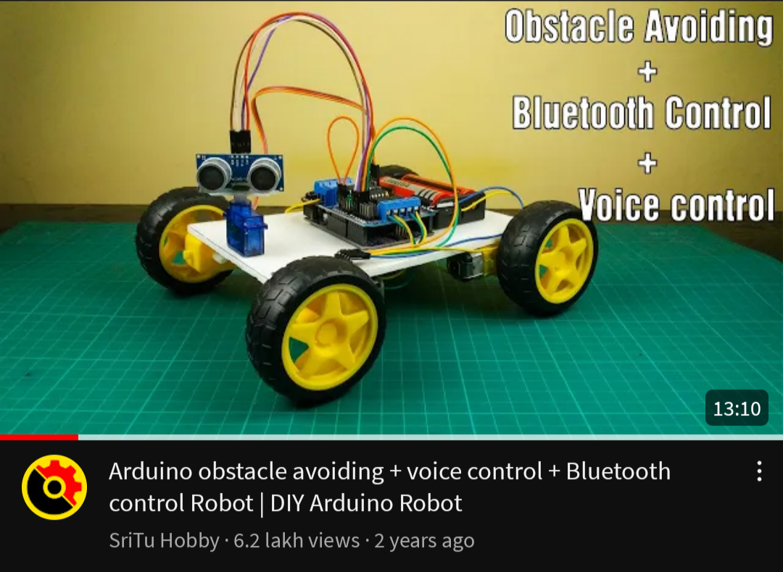
References and YouTube links:-
YOUTUBE LINK OF THE VIDEO
https://youtu.be/aE_J7B-O4VQ
Website -- https://bit.ly/3IhfCMc
Bluetooth controller -- https://play.google.com/store/apps/details?id=braulio.calle.bluetoothRCcontroller
Voice Control --
https://play.google.com/store/apps/details?id=com.broxcode.arduinobluetoothfree

Slide 16
thank you
SIGNING OFF!!!
TEAM 15

